Slide 1

First Findings on Current Drag and Incoherence in a Kelp Forest
By Jason Rooker
Dr. Derek Grimes
January 2026

Slide 2
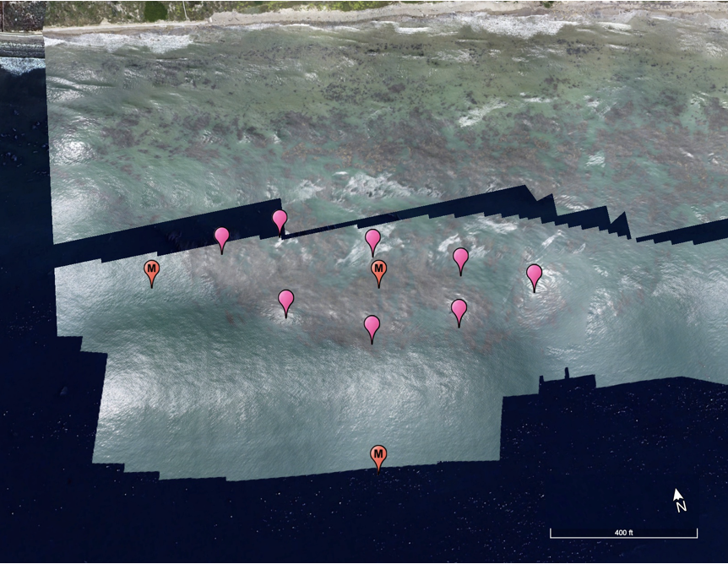
Moorings
Four ADCPs were used for this analysis.
2 x Signature 1000
AquaDopp 1Mhz
Vector
One Signature was located at M1, all others were near M2
M1
M2

Slide 3
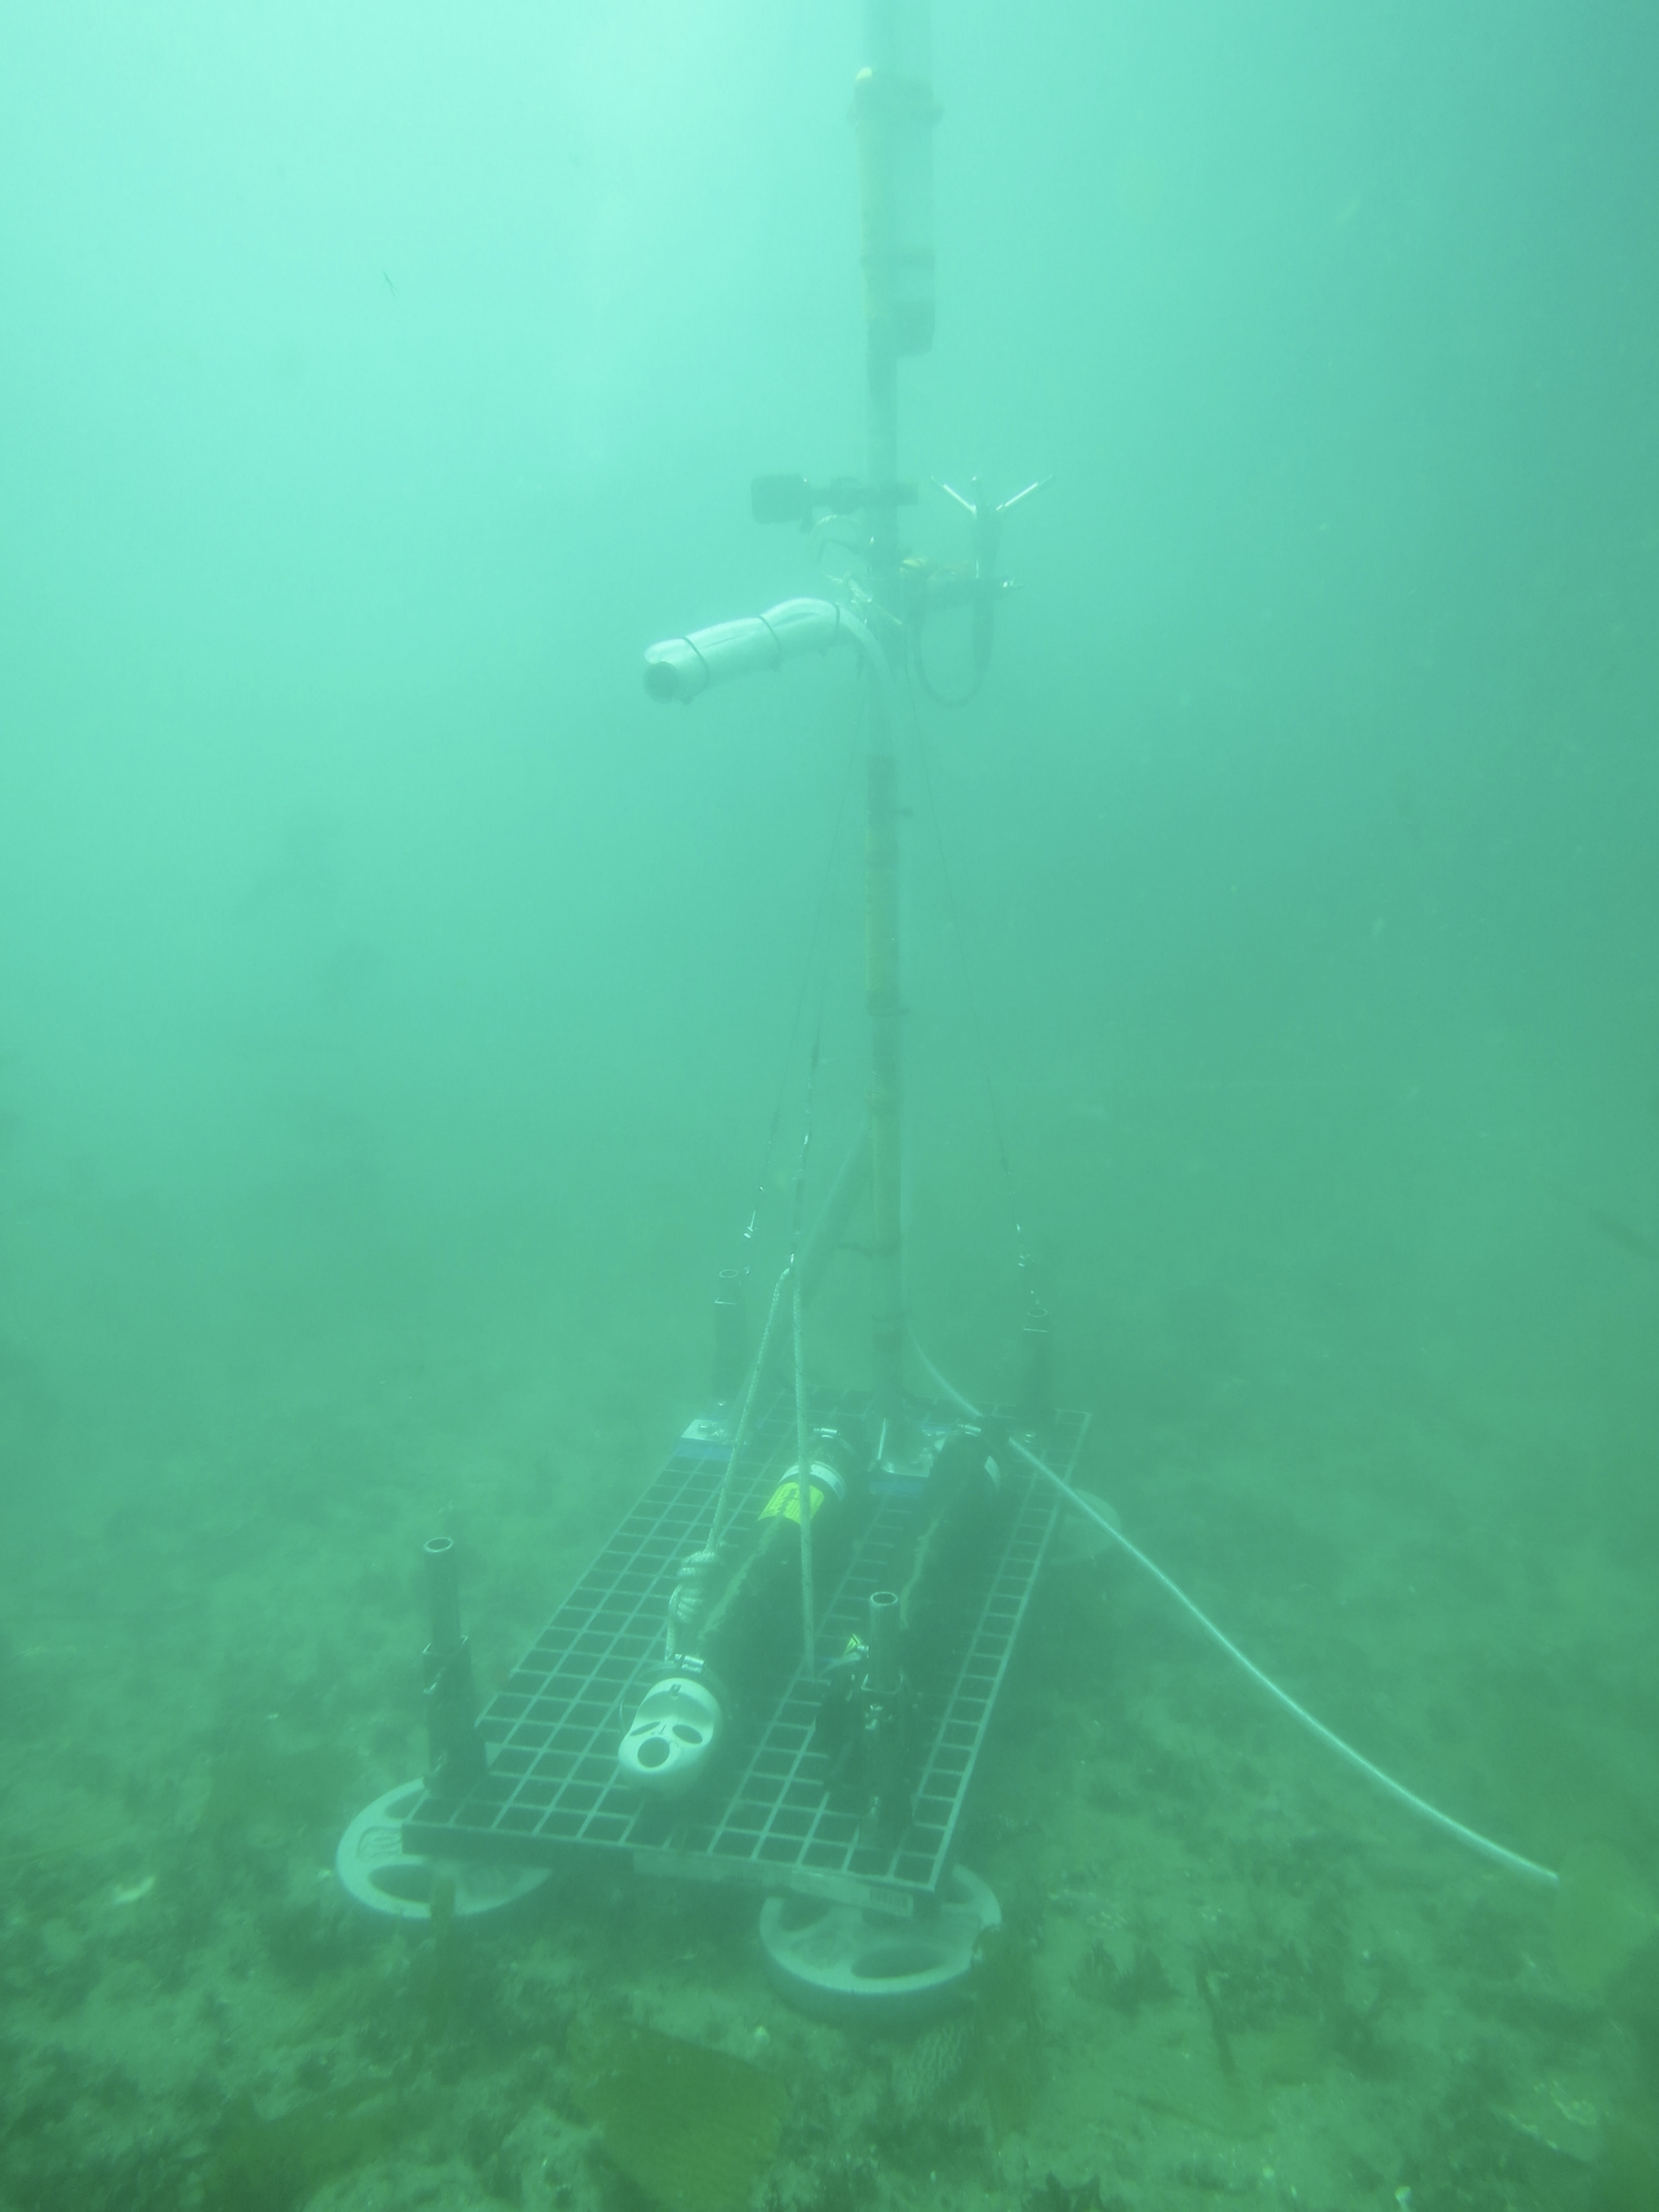
Sampling Height
Vector
The Vector is a point velocity sensor
All measurements from profilers were taken at the approximate height of the Vector sample point
1.2 meters

Slide 4
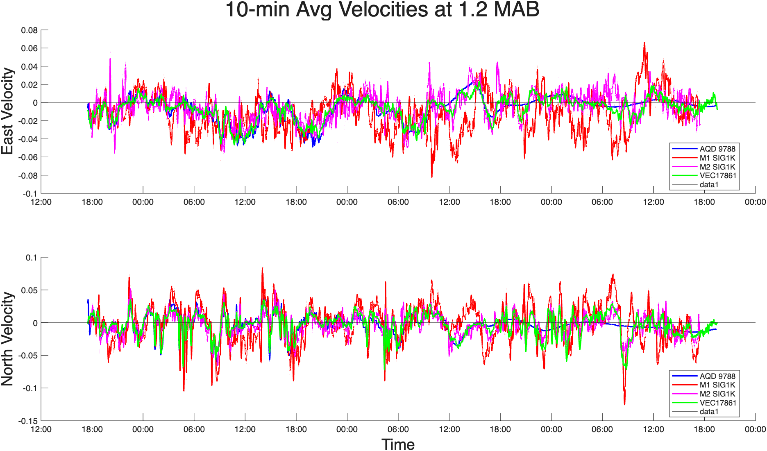
Low Pass Filter
The velocity signals were processed using a 10-minute Hamming window filter to remove noise and wave-level oscillations

Slide 5
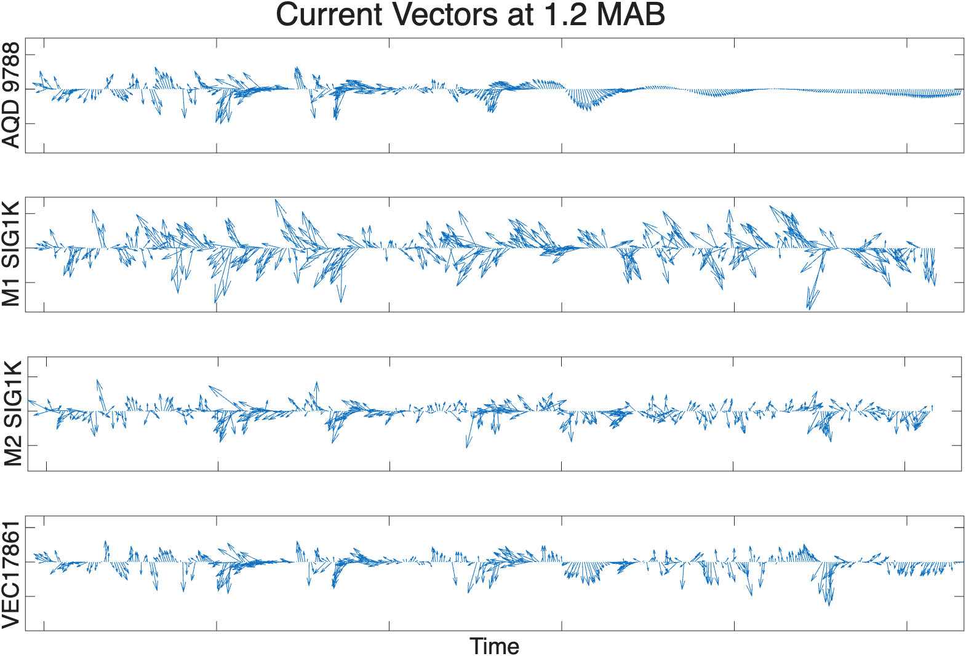
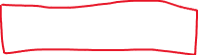
Coherence
Battery died here
All four ADCPs show similar trends in their currents, suggesting that the signals are largely coherent and do not have substantial internal wave noise
High coherence means that differences in velocities can be attributed to drag

Slide 6
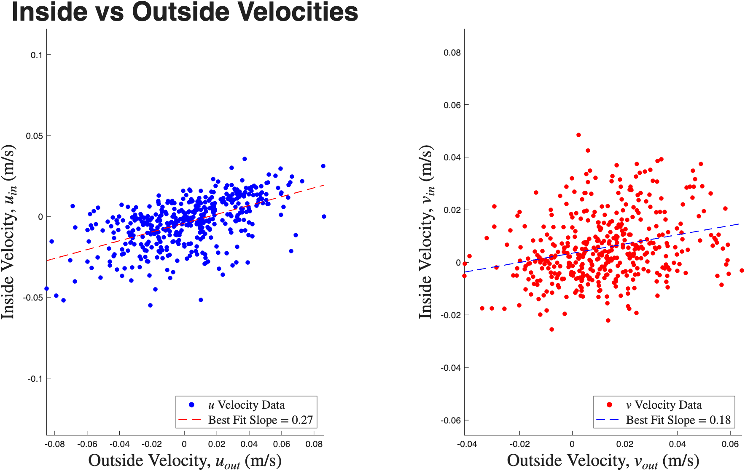
Velocity Reductions
This figure indicates the correlation between velocities measured inside versus outside the kelp forest
Inside velocities are an arithmetic average of M2 Sig1k and Vector velocities. (AQD values were excluded because of battery issues)
“u” and “v” velocities are the major and minor principal components of variability and correspond approximately to North and East, respectively

Slide 7
Conclusions
The results of this analysis show that there is measurable drag on current flow through the kelp forest.
There are no obvious signs of substantial internal waves

Slide 8
Next Steps
AQD data may be usable if data is interpolated before low pass filter is applied
Inside vs Outside velocities must be normalized for actual correlation coefficients.
Correlations at other elevations can be analyzed with AQD and M2
Correlation coefficients for Release 2 (this release) can be compared with Release 1
Quantitative analysis of coherence

